Slide 1
Development of System’s for
Effective Environment
JB_ECO VIEW

Slide 2
INTRODUCTION :
ENVIRONMENTAL SUSTAINABILITY IN SOFTWARE :
Clearly outline your environmental objectives. Determine what aspects of your software operation or usage you want to improve environmentally , such as Energy efficiency , resource utilization or emission reduction.
Conduct an environmental impact assessment to understand current state of your software equipment footprint this assessment can inform decision and actions to make the s/w more environmentally friendly and sustainable.
Assessing the environmental impact of s/w requires a holistic approach thart considers not only the code and algorithm but also infrastructure , user behavior and the entire s/w life cycle.

Slide 3
Uses of environment impact assessment :
Assessing the environmental impact of software involves evaluating various aspects of its development, deployment, and usage. Here are key factors to consider when assessing the environmental impact of software:
Energy Consumption: Determine the amount of energy consumed by the software during operation. This includes energy used by servers, data centers, and end-user devices. Evaluate energy efficiency and identify opportunities for optimization.
Resource Utilization: Assess the software's utilization of computing resources, such as CPU, memory, and storage. Efficient resource usage can reduce the environmental impact.
Emissions: Calculate the greenhouse gas emissions associated with the software's operation. This includes emissions from data centers, energy production, and other sources linked to software usage.
Data Transfer: Analyze the volume of data transferred over networks, both for cloud-based and on-premises software. Minimizing unnecessary data transfer can reduce energy consumption.
Hardware Compatibility: Consider the compatibility of the software with various hardware configurations. Inefficient software can lead to the premature replacement of hardware, contributing to electronic waste.

Slide 4

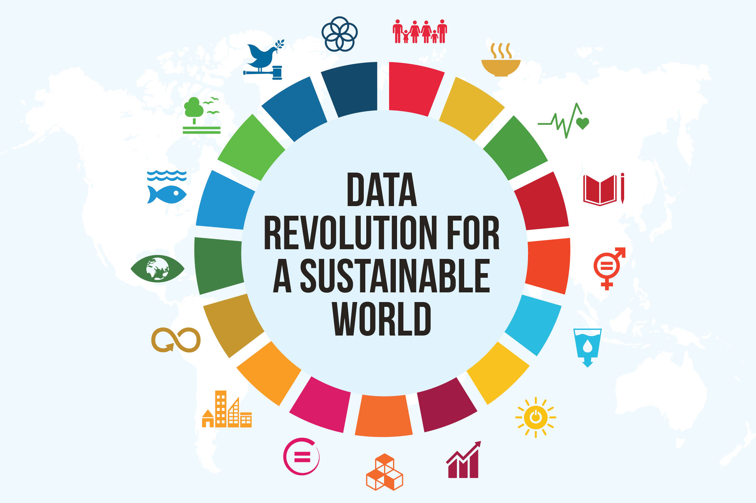


Slide 5
Influencing Factors:
Optimize Code and Algorithms: Review your software's code and algorithms to identify opportunities for optimization. This may include reducing unnecessary computations, optimizing data storage, and implementing energy-efficient algorithms.
Hardware Considerations: Consider the hardware on which your software runs. Optimize for energy-efficient hardware and take advantage of hardware capabilities for environmental improvements, such as low-power modes.
Data Center Efficiency: If your software is hosted in data centers, work on making those data centers more energy-efficient. This can involve server consolidation, efficient cooling systems, and renewable energy sourcing.
Reduce Resource Consumption: Minimize the use of resources like memory, CPU, and network bandwidth. Efficient resource usage not only improves environmental impact but also enhances software performance.
Implement Energy-Efficient Features: Design your software with energy-saving features. For example, implement automatic screen dimming in mobile apps or allow users to schedule resource-intensive tasks during off-peak hours.
User Education: Educate users about the environmental impact of your software and provide tips on how they can use it more efficiently. This can be done through in-app notifications or documentation.
.

Slide 6
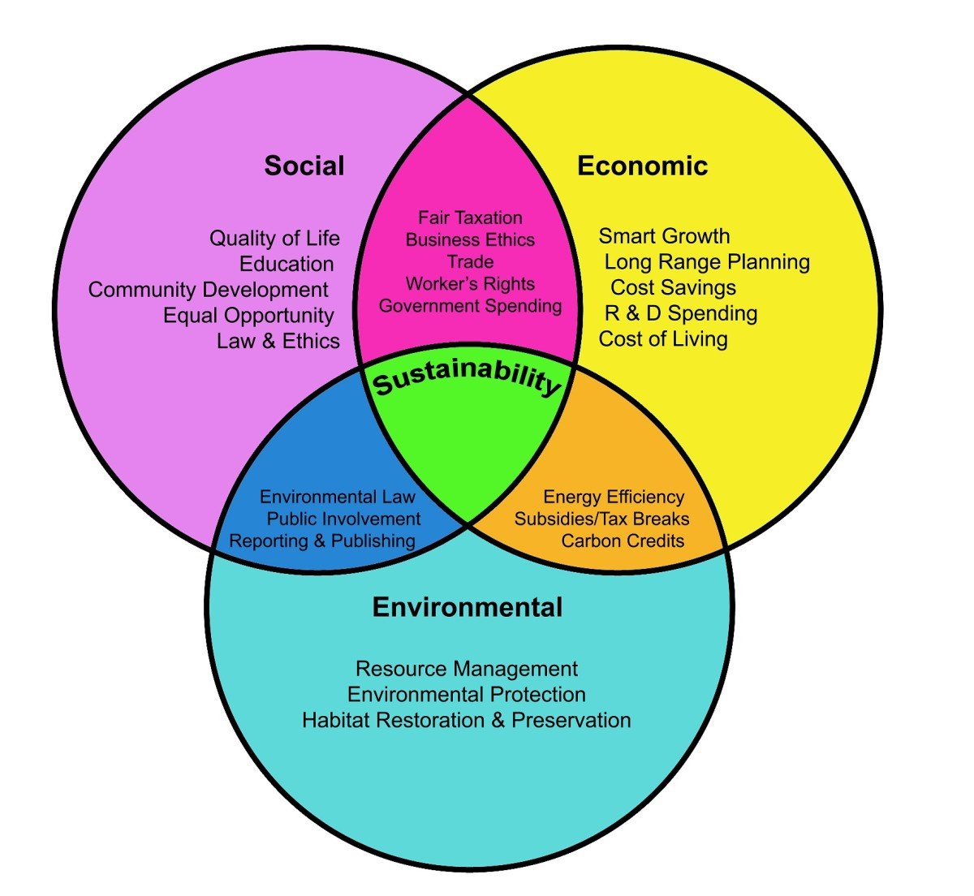


Slide 7
Several Advantages:
Sustainability: Environmental practices in software development contribute to the reduction of carbon footprints and the conservation of natural resources, helping to combat climate change and environmental degradation.
Cost Savings: Implementing environmentally friendly practices can lead to reduced energy consumption and resource use, resulting in cost savings for both development and operational phases of software.
Compliance: Many regions and industries are implementing regulations and standards related to software and its environmental impact. Developing environmentally responsible software ensures compliance with these requirements.
Energy Efficiency: Optimizing software for energy efficiency can extend device battery life, reduce energy consumption in data centers, and lower operational costs.
Resource Efficiency: Efficient software design can reduce the use of computing resources like memory, CPU, and network bandwidth, which translates to cost savings and a smaller environmental footprint.

Slide 8

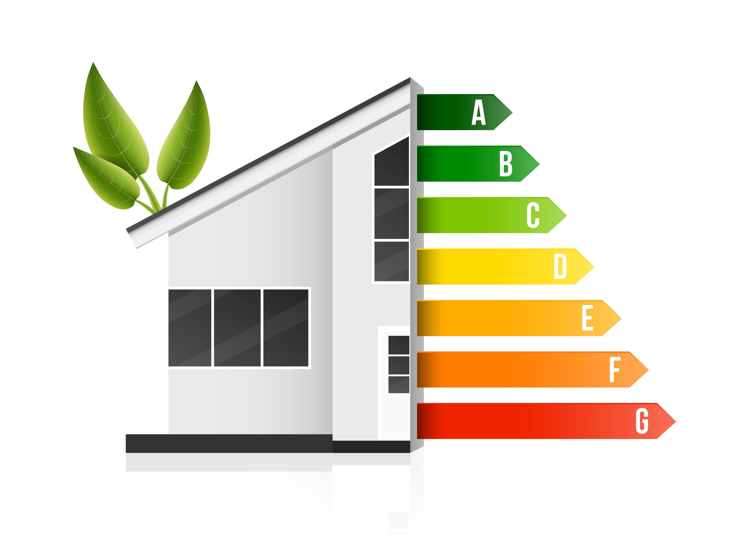


Slide 9
Solutions For Effective Environment System :
Developing effective environmental systems in software involves creating applications, tools, and platforms that help monitor, manage, and improve environmental sustainability. Here are some key solutions and considerations:
Energy Management: Create software solutions for energy management and optimization, helping organizations and individuals track and reduce energy consumption.
Carbon Footprint Tracking: Build tools that allow businesses and individuals to calculate and track their carbon emissions, helping them make informed decisions to reduce their environmental impact.
Environmental Compliance: Create systems that assist organizations in ensuring compliance with environmental regulations and reporting requirements.
GIS (Geographic Information Systems): Utilize GIS software to map and analyze environmental data, aiding in spatial planning, conservation, and disaster response.
IoT Integration: Utilize the Internet of Things (IoT) to collect real-time environmental data from sensors and devices for analysis and decision-making.
Effective environmental software systems require collaboration between software developers, environmental experts, and policymakers to ensure they are accurate, user-friendly, and aligned with sustainability goals. These systems can play a crucial role in addressing environmental challenges and promoting sustainable practices.

Slide 10
Conclusion:
Play an integral role in software creation, management, and maintenance.
Enable developers to do testing and verify that programs will function as expected.
Help developers to make code changes in a controlled environment, without affecting users.

Slide 11


